Slide 1
Four Central Themes of Spiritual Preparation

Slide 2
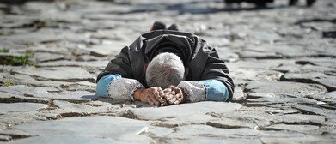
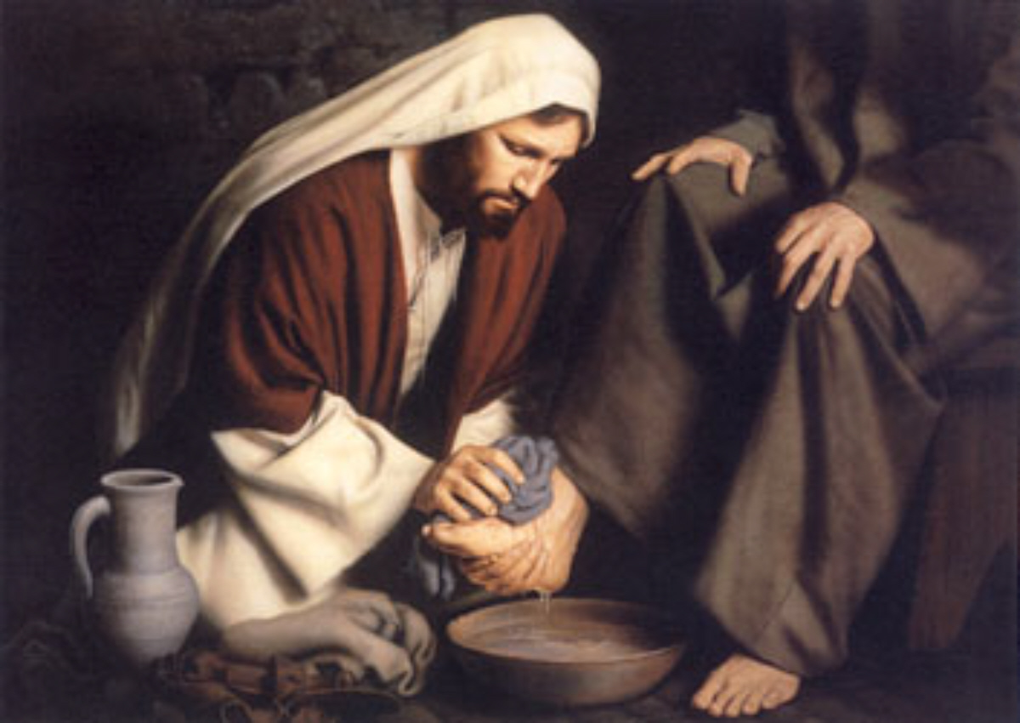
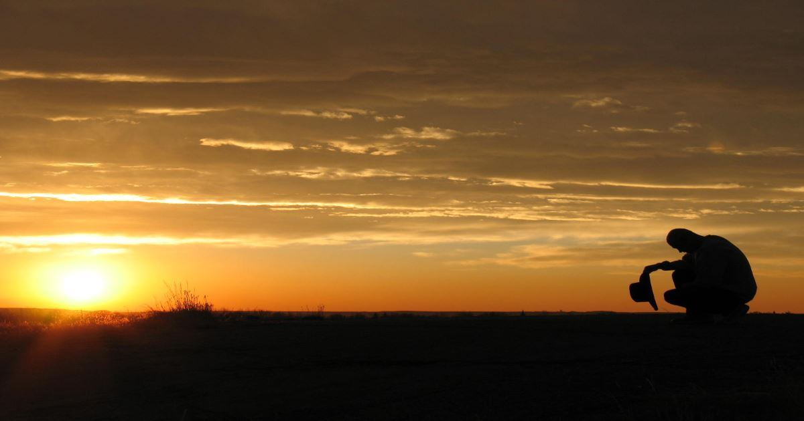
We Must Enter into the Depths of Humility

Slide 3
HUMIL'ITY, noun [Latin humilitas.] Webster’s Dictionary 1828
1. In ethics, freedom from pride and arrogance; humbleness of mind; a modest estimate of one's own worth. In theology, humility consists in lowliness of mind; a deep sense of one's own unworthiness in the sight of God, self-abasement, penitence for sin, and submission to the divine will.
Before honor is humility Proverbs 15:33.
Serving the Lord with all humility of mind. Acts 20:19.
2. Act of submission.

Slide 4
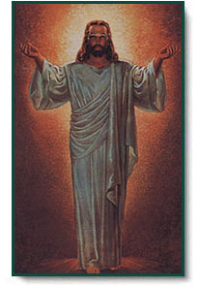
Humility is the key to the door that unlocks the spiritual blessings of God. See Mosiah 2:21-23
The Natural consequence [product] of our coming to understand just how much God loves us and that His hand is in all things. See DC 59:5b
We cannot see ourselves as God sees us until we have humbled ourselves into the depths of humility.
We cannot fully repent of our sins and forsake them until we have humbled ourselves in the depths of humility.
- From the Pamphlet: Spiritual Preparation of the Body of Christ 2004

Slide 5
Examples From the Scriptures
Philippians 2:7-8 Christ humbled himself
Luke 18:9-14 Pharisee and the Publican
See also Alma 16:98, Alma 18:16
Pharisee: Strict adherence to the law. Largest Jewish sect at that time.
Publican: Jewish tax/toll collectors, worked for the Romans. Untrusted and disliked by most other jews.
Luke 7:37-50 Mary washes Jesus’ feet
Who do you think was humbled more in this experience, Mary, or Simon?
John 13:5, 12-17 Jesus washes the feet of the disciples
If Jesus came to your home today, would you allow him to wash your feet?
Does it require more humility to serve another, or to allow someone to be in your service?

Slide 6
How Can We Achieve/Demonstrate Humility
DC 11:4 No one can assist in this work, except…
DC 17:7 Concerning the manner of Baptism
DC 17:18c Godly walk and conversation…works and faith
Philippians 2:3-4 Each Esteem Other
Luke 14: 8-11 Parable of the Wedding
DC 10:6 Do justly, judge righteously
See also Micah 6:8
Helaman 2:29-31 fast and pray oft, and did wax stronger and stronger in their humility

Slide 7
Compelled or Choosing to be Humble
Alma 16:134-138 Compelled vs Choosing
Does a blessing still exist if we have to be compelled to be humble?
Will a compelling to be humble always produce a humble reaction?
Ether 5: 28 I give unto men weakness…
Is this weakness compelling us to be humble, or just an avenue for God to show us our frailty? Jacob 3:8-9
DC 5:5a-b Humble himself in mighty prayer and faith
DC 18:2k lest I humble you by my almighty power
Darkness is most devastating to those that have known the light
Alma 19:112-114 Compelled by our own sin
Luke 15:11-19 Prodigal Son [I] am no more worthy to be called thy son
Who was responsible for his condition, and for his decision to return?
Helaman 3-4 4:4 Nephi prays for famine to stir the people to remembrance rather than them being destroyed by the sword

Slide 8
Promises if We are Humble
Mat 23:1-9 He that humbleth himself shall be exalted
Should we have an expectation of being lifted up if we humble ourselves?
DC 1:5a-c They might be made strong
Have there been times the Lord has answered your prayers after you have lowered yourself in humility? Are there times he didn’t because you did not?
DC 28:1a the great I AM…who will gather his people even as a hen gathereth her chickens
Mosiah 2:21-23 be filled with the love of God
DC 61:6c the blessings of the kingdom are yours
What are some of the blessings of the kingdom?

Slide 9
Parting Thought
Matthew 7
29 Wherefore by their fruits ye shall know them.
30 Verily I say unto you, It is not every one that saith unto me, Lord, Lord, that shall enter into the kingdom of heaven; but he that doeth the will of my Father who is in heaven.
Let us not just speak of humility, but let us pursue it, live it, and teach it through the gracious and merciful spirit of Christ that is in us.

Slide 10
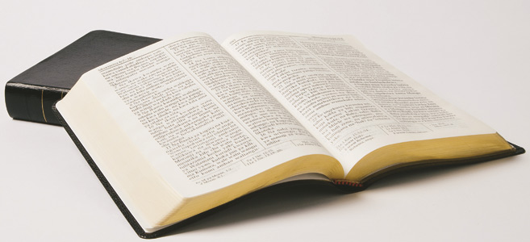
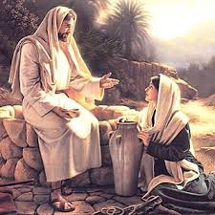
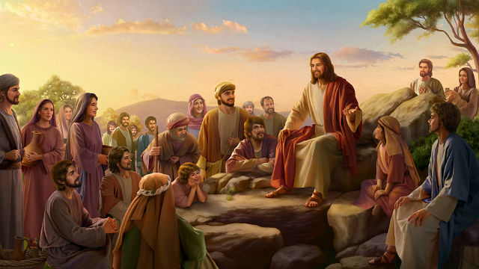
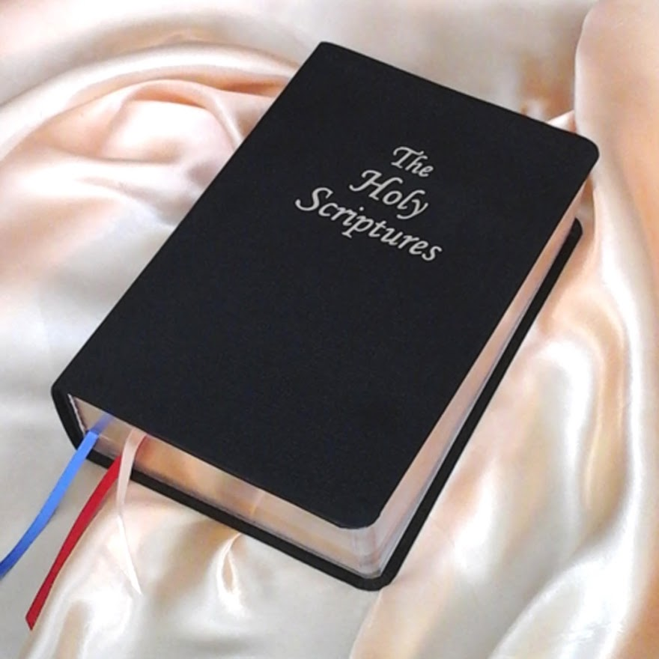
We Must Feast Upon the Words of Christ

Slide 11
What say you, Mr. Webster?
FEAST, verb intransitive
1. To eat sumptuously; to dine or sup on rich provisions; particularly in large companies, and on public festivals.
2. To be highly gratified or delighted.
GOS'PEL, noun [Latin evangelium, a good or joyful message.]
The history of the birth, life, actions, death, resurrection, ascension and doctrines of Jesus Christ; or a revelation of the grace of God to fallen man through a mediator, including the character, actions, and doctrines of Christ, with the whole scheme of salvation, as revealed by Christ and his apostles. This gospel is said to have been preached to Abraham, by the promise, 'in thee shall all nations be blessed.' Galatians 3:8.
It is called the gospel of God. Romans 1:1.
It is called the gospel of Christ. Romans 1:16.
It is called the gospel of salvation. Ephesians 1:13.
1. God's word.
2. Divinity; theology.
3. Any general doctrine.

Slide 12
Why Must We Feast Upon His Word?
John 14:26
26 But the Comforter, which is the Holy Ghost whom the Father will send in my name, he shall teach you all things, and bring all things to your remembrance, whatsoever I have said unto you.
3 Nephi 12:33-35 (This is my gospel)
33 Now this is the commandment, Repent, all ye ends of the earth, and come unto me and be baptized in my name, that ye may be sanctified by the reception of the Holy Ghost, that ye may stand spotless before me at the last day.
34 Verily, verily I say unto you, This is my gospel; and ye know the things that ye must do in my church; for the works which ye have seen me do, that shall ye also do;
35 For that which ye have seen me do, even that shall ye do; therefore if ye do these things, blessed are ye, for ye shall be lifted up at the last day.
3 Nephi 13:5 (Be like Christ)
5 …what manner of men ought ye to be? Verily I say unto you, Even as I am…
We must know what He said and did, if we want to remember and do.

Slide 13
Everlasting Gospel
DC 26:2a …Book of Mormon, containing the fullness of my everlasting gospel;
DC 16:1 …rely upon the things which are written; for in them are all things written concerning the foundation of my church, my gospel, and my Rock;
DC 108:11a …that men might be partakers of the glories…the Lord sent forth the fullness of the gospel, his everlasting covenant…
DC 52:4b …I will give unto you a pattern in all things, that ye may not be deceived…

Slide 14
What Qualifies as the Word of Christ?
2 Timothy 3:16 And all scripture given by inspiration of God, is profitable for doctrine, for reproof, for correction, for instruction in righteousness;
2 Nephi 14:1-4 …Angels speak by the power of the Holy Ghost; wherefore, they speak the words of Christ.
DC 68:1b-c …whatsoever they shall speak when moved upon by the Holy Ghost shall be Scripture…shall be the word of the Lord…
DC 43:7c for the great millennial, which I have spoken by the mouth of my servants, shall come…
DC 50:7f and, behold verily I say unto you, Blessed are you who are now hearing these words of mine from the mouth of my servant…

Slide 15
I’m Feasting, Am I Done?
Mat 6:21, Luke 12:37, 3 Nephi 5:112
For where your treasure is, there will be your heart also.
Time is our most valuable asset. How we spend it is a reflection of what we truly value.
DC 6:15c-d
c …for whatsoever ye sow, that shall ye also reap:
d therefore, if ye sow good, ye shall also reap good for your reward:

Slide 16
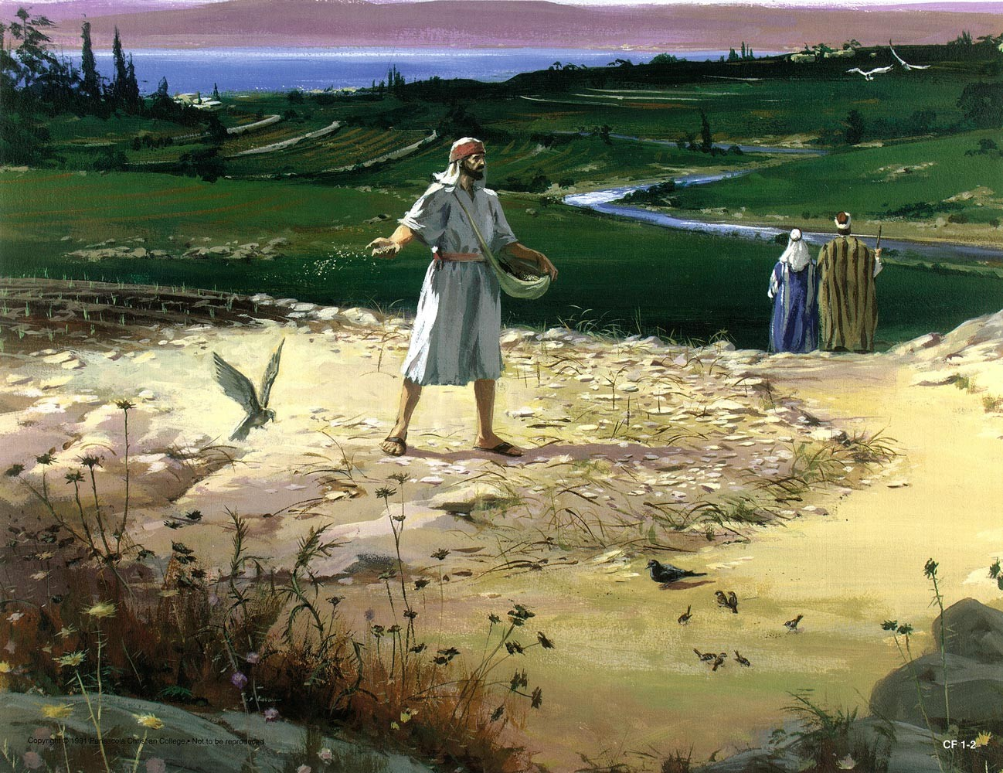
Parable of the Sower
Psalm 1:1-2 …But his delight is in the law of the Lord; and in his law doth he meditate day and night.
[4 responses to the gospel are found in these verses]
Mat 13:3-7 The Parable of the Sower (Also see Mark4 and Luke 8)
Mat 13:17-21 The Parable Explained

Slide 17
Responses to the Gospel
Psalm 1 Blessed is the man that… | Mat 13:3-7 Some seeds fell… | Mat 13:17-21 Description and Result
Walketh not in the counsel of the ungodly, | By the wayside | -Heareth the word, and understandeth not -Then cometh the wicked one and catcheth away that which was sown in his heart
Nor standeth in the way of sinners, | Upon stony places | -Heareth the word and readily with joy receiveth it -Hath not root in himself, and endureth but for awhile -When tribulation or persecution ariseth because of the word, he is offended
Nor sitteth in the seat of the scornful. | Among thorns | -Heareth the word -The Care of this world and the deceitfulness of riches, choke the word -He becometh unfruitful
His delight is in the law of the Lord | Into good ground | -Heareth the word and understandeth and endureth -Beareth fruit, some hundredfold, some sixty and some thirty
UNDERSTAND : To be informed by another; to learn.

Slide 18
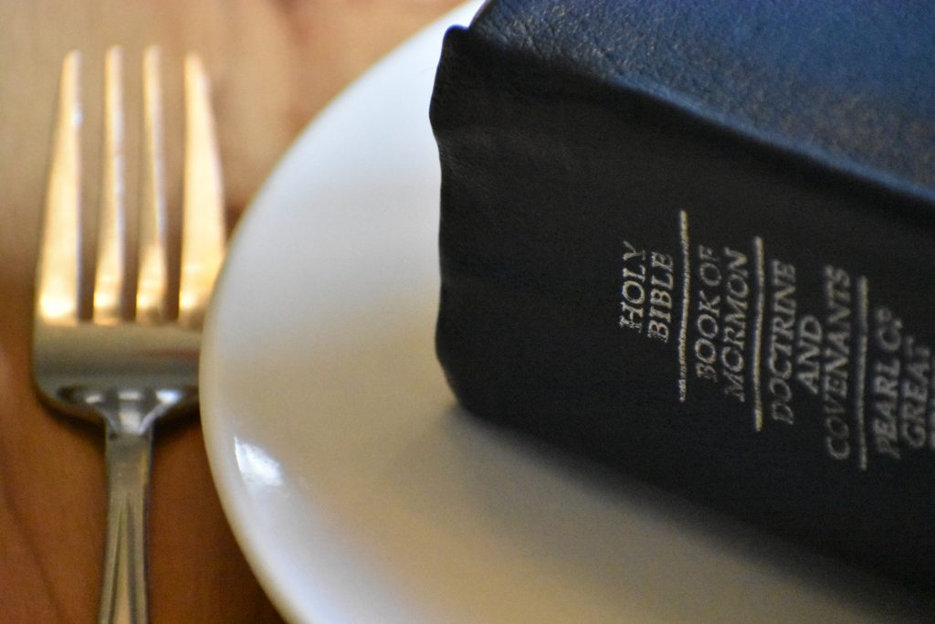
Feast Upon the Words of Christ Parting Thoughts
Mat 24:39, Mark 13:43
And whoso treasureth up my word(s),
shall not be deceived.
2 Nephi 14:4-5
4 …Feast upon the words of Christ; for behold the words of Christ will tell you all things what you should do.
5 Wherefore, now after I have spoken these words, if ye can not understand them, it will be because ye ask not, neither do ye knock;…
2 Nephi 13:30
Wherefore, if ye shall press forward, feasting upon the word of Christ, and endure to the end, behold thus saith the Father: Ye shall have eternal life.

Slide 20
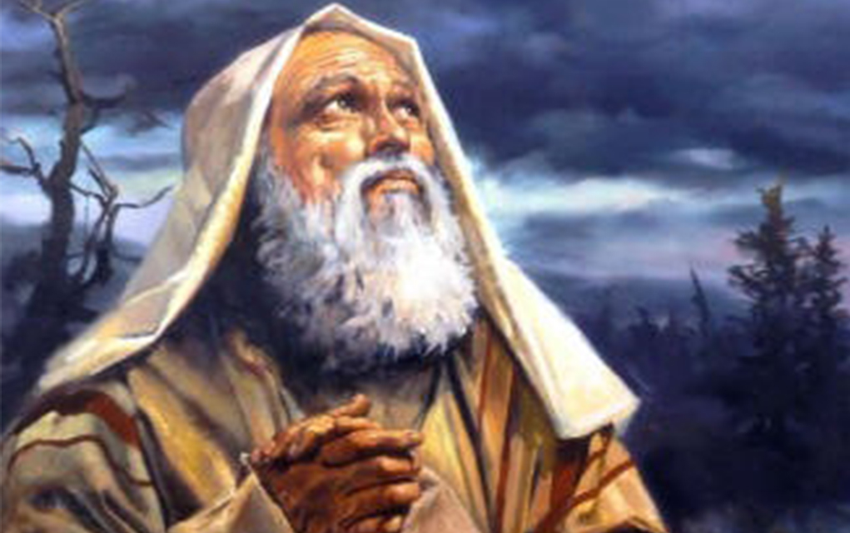
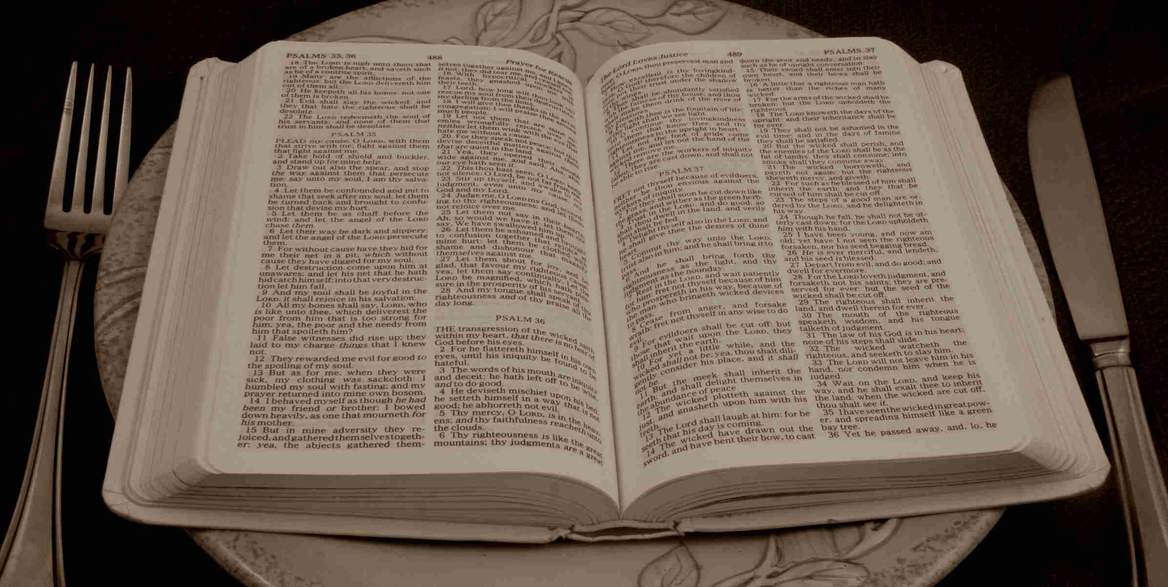
We Must Continue in Prayer and Fasting

Slide 21
Continue in Prayer and Fasting
DC 85:21
a. Also, I give unto you a commandment, that ye shall continue in prayer and fasting from this time forth.
b. And I give unto you a commandment, that you shall teach one another the doctrine of the kingdom; teach ye diligently and my grace shall attend you, that you may be instructed more perfectly in theory, in principle, in doctrine, in the law of the gospel, in all things that pertain unto the kingdom of God, that is expedient for you to understand;
Omni 1:47
Yea, come unto him, and offer your whole souls as an offering unto him, and continue in fasting and praying, and endure to the end; and as the Lord liveth, ye will be saved.

Slide 22
What is Prayer?
True prayer is fundamentally a fellowship with God, a method of communication with the Divine. It is a growing acquaintance, and it develops into a knowledge of God.
…Prayer is an adjustment to and an acceptance of God. It permits us to take him seriously, not as a force to be feared but as a Father to be loved and revered. Prayer helps us to conform to his laws…Prayer also is a deep sensing of our dependence upon God, with a realization of our kinship to him…
…Prayer, then, is the conscious attempt so to order our lives that we may feel the presence of God.
-The Prayer Meeting, Herald House, 1948

Slide 23
When to Pray?
1 Thess 5:17 Pray without ceasing.
DC 90:8d Pray always, lest that wicked one have power in you…
Mos 11:149 …being commanded of God to pray without ceasing, and to give thanks in all things.
Alma 16:238 be watchful unto prayer continually
2 Nephi 14:12 ye must pray always and not faint
Luke 18:1 And he spake a parable unto them, saying, that men ought always to pray and not faint.
Alma 16:219-222 Cry unto him when…

Slide 24
What is fasting?
F'ASTING, participle present tense Abstaining from food.
F'ASTING, noun The act of abstaining from food.
Yes, but more than that…
Isa 58: 5-14 Is this such a fast I have chosen…

Slide 25
Is Your Heart in it?
Mat 6:5,7 [see also 3 Nep 6:97,99]
When thou prayest, thou shalt not be as the hypocrites…standing in the synagogues and in the corners of the streets, that they may be seen of men…
…use not vain repetitions, as the hypocrites do; for they think they will be heard for much speaking.
Mat 6:17-18 [see also 3 Nep 108-109]
…when ye fast, be not as the hypocrites, of a sad countenance; for they disfigure their faces, that they may appear unto men to fast…
But thou, when thou fastest, anoint thy head and wash thy face, that thou appear not unto men to fast, but unto thy Father who is in secret; and thy Father who seeth in secret, shall reward thee openly.

Slide 26
Prayer and Fasting Some Examples
Neh 1:3-4, 2:4 Prayed and fasted on behalf of Jerusalem
Dan 9:3 Daniel prays and fasts for the restoration of Jerusalem
Psa 35:11-14 David prayed and fasted for his enemies
Mos 11:179-185 Alma (the father) and the priests prayed and fasted for Alma (the son)
Alma 3:73-79 Alma shares that he fasted and prayed for confirmation/knowledge
Alma 4:6 …fasting and mighty prayer, in behalf of the welfare of the souls of those who knew not God

Slide 27
Prayer and Fasting Some More Examples
Alma 12:4-5, 14-15 Sons of Mosiah received blessings from fasting and prayer, and also did so for their safety
Alma 21:2 Therefore they [people of Nephi] gave thanks unto the Lord their God: yea, and they did fast much, and they did worship God with exceeding great joy.
Hel 2:31 …they did fast and pray oft, and did wax stronger…
3 Nep 12:14-16 the disciples pray and fast for guidance in naming the church
Moroni 6:6 And the church did meet together oft, to fast and to pray, and to speak one with another concerning the welfare of their souls: and they did meet together oft to partake of bread and wine, in remembrance of the Lord Jesus;

Slide 28
Do You Need a Reason to Pray and Fast? How about…
For an unrighteous people
For your enemies
For your loved ones
For knowledge, understanding, and/or confirmation
For those that don’t know God
For strength in your ministry
For safety
As part of worship
To exercise humility and strengthen your faith
For guidance
For the welfare of your soul

Slide 29
Unity in Purpose
The High Priests of the Restoration Branches as well as many other groups and branches have asked the Saints to observe each Sunday as a day of fasting and prayer. There are many reasons for asking the Saints to fast and pray. The ultimate objective, however, is for the return of Jesus Christ in His Glory and the establishment of His Kingdom (Zion) on earth.
JESUS is our chief example regarding fasting and prayer, as he fasted and prayed often, as indicated in the scriptures. In our efforts to grow spiritually, we always hear fast, pray, and study.
We understand fasting to be the practice of deliberately abstaining from food for spiritual purposes. Fasting is a means by which a believer brings his body into subjection. Fasting breaks down the barriers in man's carnal nature that stand in the way of the Holy Spirit's omnipotence…Pray about fasting before you start and plan your program.
-Excerpt from a weekly email sent by High Priest Paul Gage dated 7/25/2020

Slide 30
Continue in Prayer and Fasting Parting Thoughts
Joel 2:12-13
12 Therefore also now, saith the Lord, turn ye even to me with all your heart, and with fasting, and with weeping, and with mourning;
13 And rend your heart, and not your garments, and repent, and turn unto the Lord your God; for he is gracious and merciful, slow to anger, and of great kindness, and he will turn away the evil from you.
DC 85:21 December 27,1832, a.k.a. The Olive Leaf
a. Also, I give unto you a commandment, that ye shall continue in prayer and fasting from this time forth.

Slide 31
Continue in Prayer and Fasting Parting Thoughts, just one more
4 Nephi 1:3,4,6,9,11,12,13,19
3 …the people were all converted unto the Lord… both Nephites and Lamanites, and there were no contentions and disputations among them, and everyman did deal justly one with another;
4 And they had all things common among them…
6 and there were great and marvelous works wrought by the disciples of Jesus…
9 And the Lord did prosper them exceedingly, in the land…
11 …the people of Nephi did wax strong…and became an exceedingly fair and delightsome people.
12 …and were blessed according to the multitude of the promises which the Lord had made unto them.
13 …they did walk after the commandments which they had received from the Lord and their God, continuing in fasting and prayer, and in meeting together oft, both to pray and to hear the word of the Lord.
19 And surely there could not be a happier people among all the people who had been created by the hand of God;

Slide 33
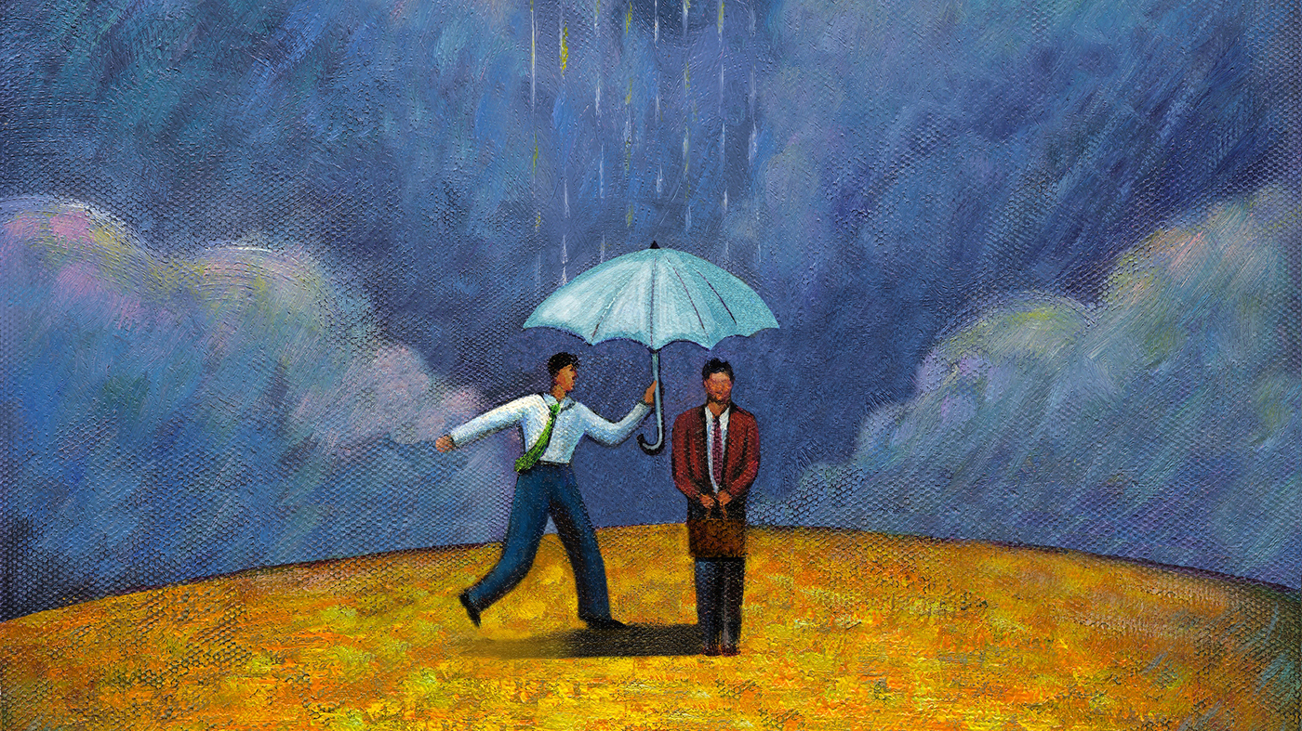
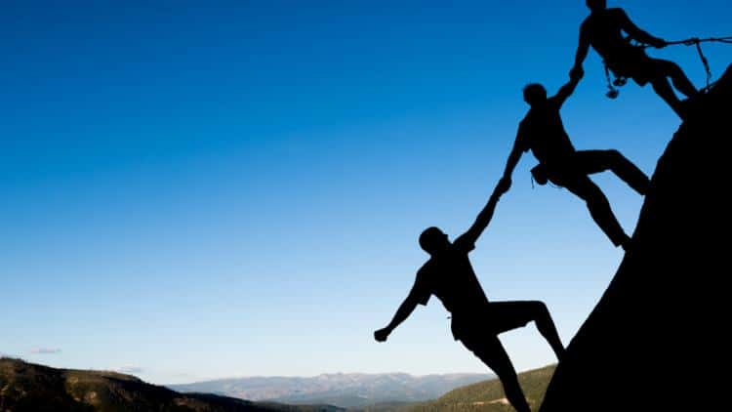
We Must Work Tirelessly on Behalf of the Welfare of Others

Slide 34
Christ, the example
Matthew, Mark, Luke, John… The works of Christ as he dwelt in the flesh
John 15:12-13
12 This is my commandment, That ye love one another, as I have loved you.
13 Greater love hath no man than this, that a man lay down his life for his friends.
3 Nephi 13:5 (Be like Christ)
…what manner of men ought ye to be? Verily I say unto you, Even as I am…
DC 16:3c
Remember the worth of souls is great in the sight of God; for, behold, the Lord your Redeemer suffered death in the flesh; wherefore he suffered the pain of all men, that all men might repent and come unto him.

Slide 35
Together…
Gen 7:23 [DC 36:2h-i]
23 And the Lord called his people, Zion, because they were of one heart and one mind, and dwelt in righteousness; and there were no poor among them.
DC 42:12e
Thou shalt live together in love…
DC 1:2e
…the Lord shall come to recompense unto every man according to his work, and measure to every man according to the measure which he has measured to his fellow man.

Slide 36
Love Others In Word and Deed
DC 85:38a
See that ye love one another; cease to be covetous; learn to impart one to another as the gospel requires; cease to be idle;…
? Is it possible to covet our beliefs/spirituality?
Mat 22:38 [Lev 19:18, Mat 19:19, Mark 12:36, Rom 13:9, Gal 5:14, James 2:8, DC 59:2b]
…Thou shalt love thy neighbor as thyself.
Mat 7:21
Therefore, all things whatsoever ye would that men should do to you, do ye even so to them; for this is the law and the prophets.
1 John 4:21
And this commandment have we from him, That he who loveth God love his brother also.

Slide 37
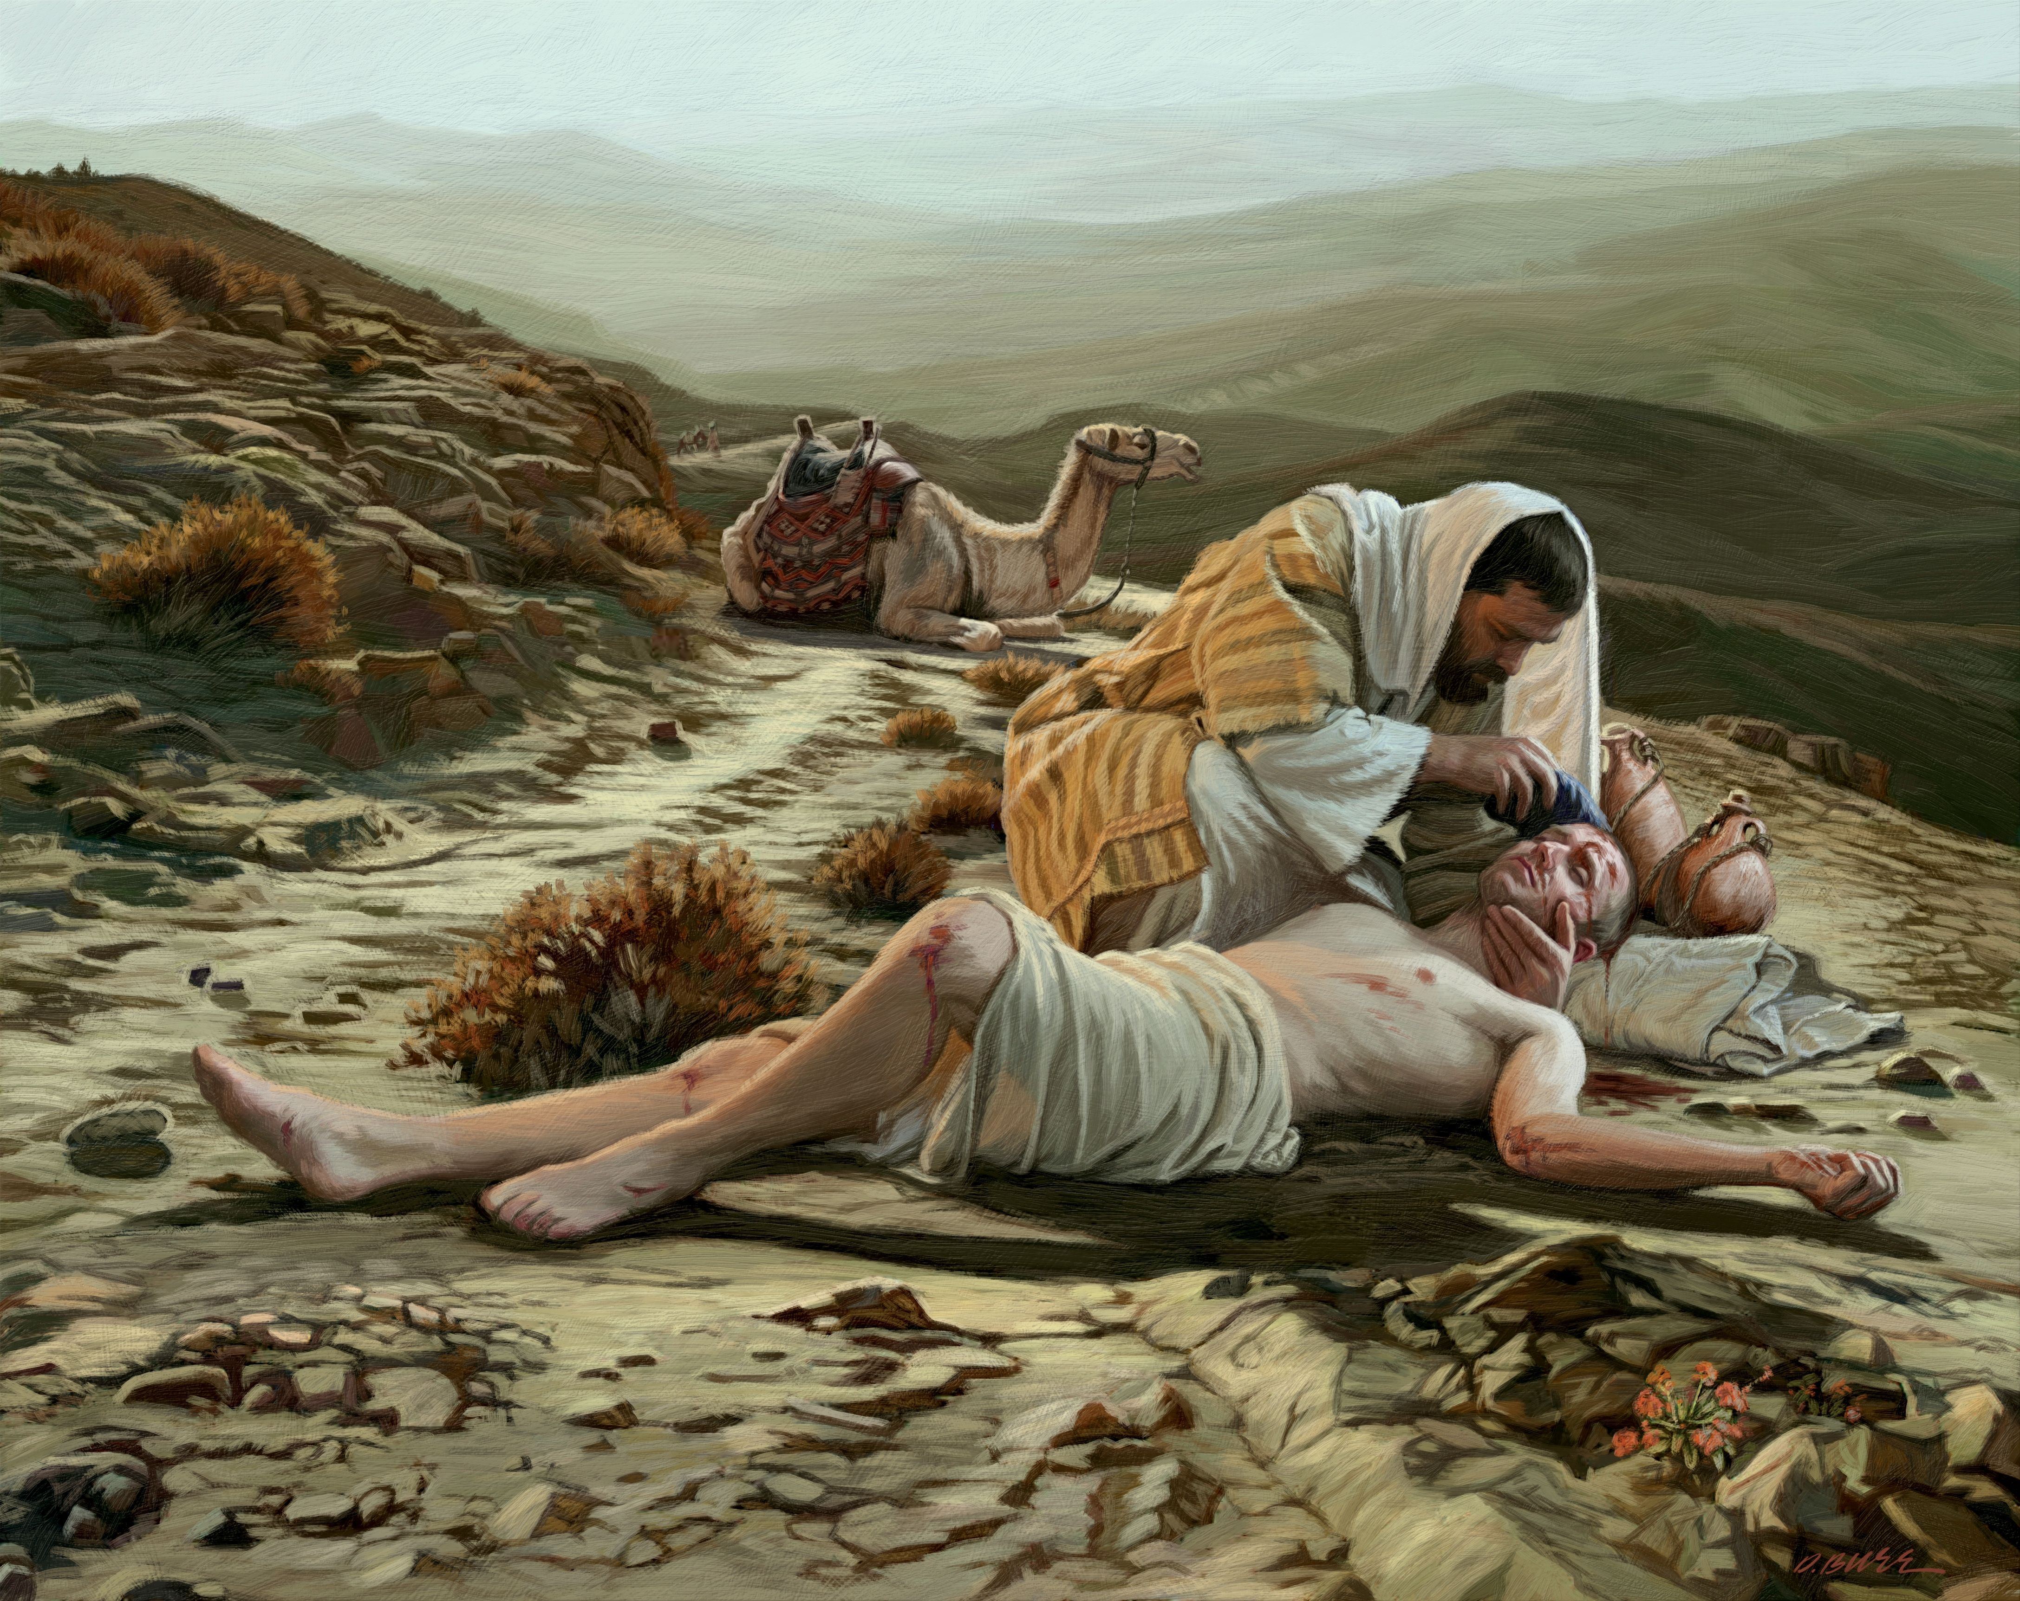
The Good Samaritan - Luke 10:25-38
38: …Then said Jesus unto him, Go, and do likewise.
? Physical needs are often easy to discern. Are you/we responding to these needs?
? How about the spiritual needs of your neighbor? Other members of the church? Your family?
? Does the parable show that we should only do the minimum?

Slide 38
Question Time
? As individuals, and a people, who proclaim to be followers of Christ, is it necessary to actively seek out and attempt to do good works on behalf of others?
DC 58:6d-e
? Do our labors on the behalf of others inherently improve our own lives? Do we directly benefit from the positive things we do for others?
? If so, should this be the motivating factor for us to do them?
? Do you feel more blessed when someone does something for you, or when you do something for someone else? Or do you feel the same?

Slide 39
Parting Thoughts
Alma 16:222
…let your hearts be full, drawn out in prayer unto him continually for your welfare, and also for the welfare of those who are around you.
DC 16:3f (to Oliver Cowdery and David Whitmer)
And if it so be that you should labor all your days, in crying repentance unto this people, and bring save it be one soul unto me, how great shall be your joy with him in the kingdom of my Father!

Slide 40
